Slide 1

Automated Deployment Pipeline with Jenkins and Docker Project
Supervised by:
Eng. Ahmed Nasr
Team member:
Andrew Adel Hosny Goued
John Samy Roshdy
Mostafa Hesham Ragab Allam
Kirolos Nagy Marzouk Ibrahim
Khalid Mohamed Mahmoud Salman

Slide 2


Project Overview
Objective:
To automate the Continuous Integration/Continuous Deployment (CI/CD) process using Jenkins, Docker, and Ansible.
The pipeline automates the build, test, and deployment of a Dockerized application.
Key Features:
Uses Jenkins for orchestrating the pipeline.Docker for containerizing the app.
Ansible for deployment automation.

Slide 3
Pipeline

Slide 4
Email Notifications

Slide 5
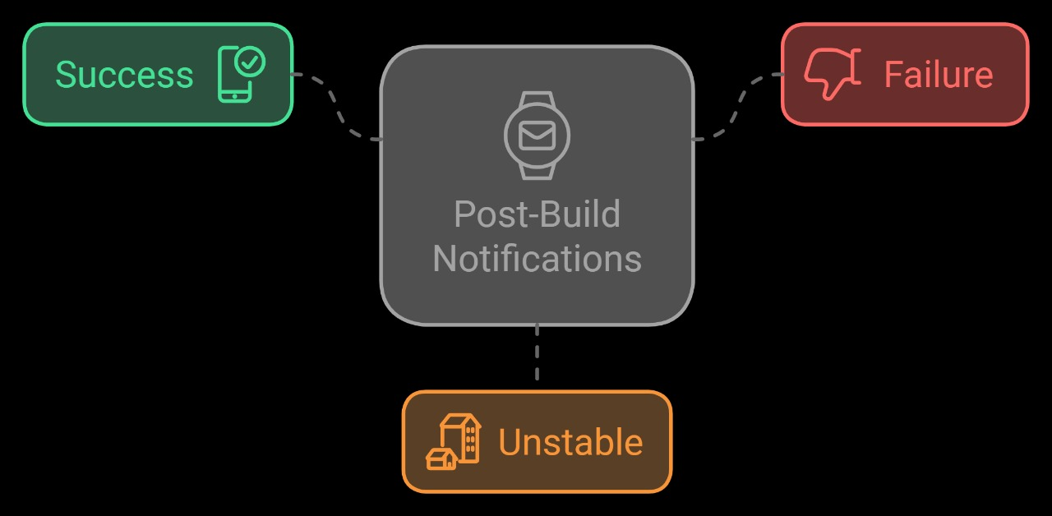
Post-Build Notifications
Purpose:
Send email notifications based on the build status.
Explain:
Sends an email if the build fails or becomes unstable, ensuring the team is notified for immediate action.

Slide 6
Stages

Slide 7
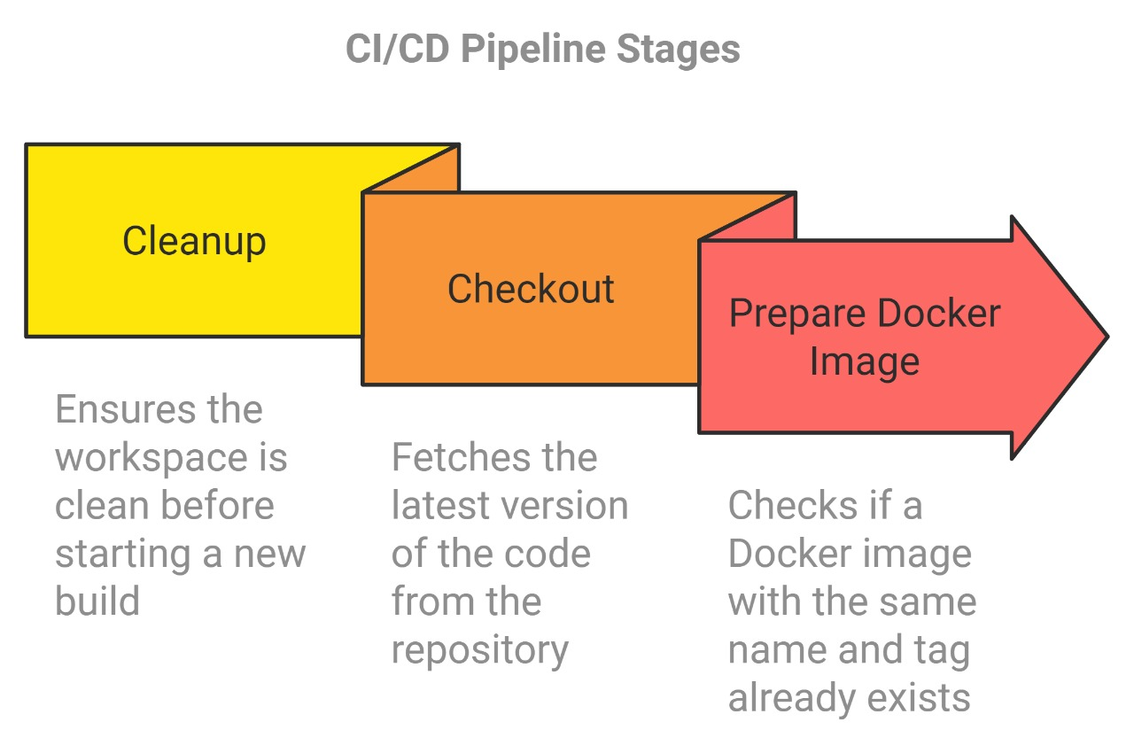
Preparing Stages

Slide 8
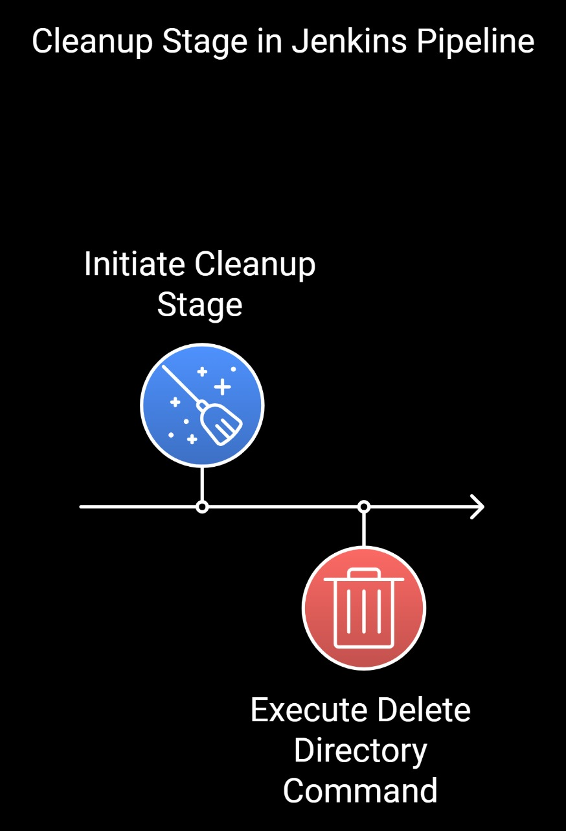
Stage 1: Cleanup
Purpose:
Ensure that no old files or directories from previous builds interfere with the current build.
Explain:
This stage deletes the entire workspace directory, ensuring a clean environment before proceeding.

Slide 9
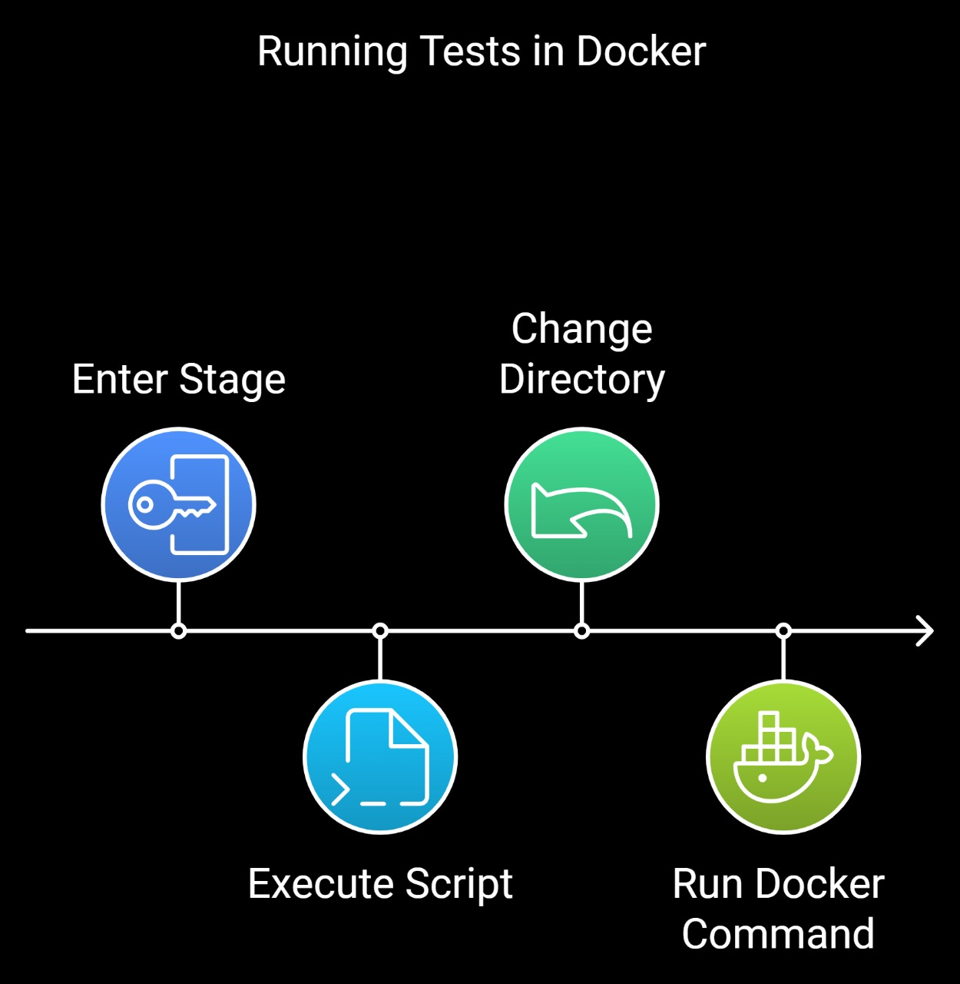
Stage 2: Checkout
Purpose:
Retrieve the source code from the GitHub repository
Explain:
The pipeline checks out the latest version of the code from the master branch using GitHub credentials.

Slide 10
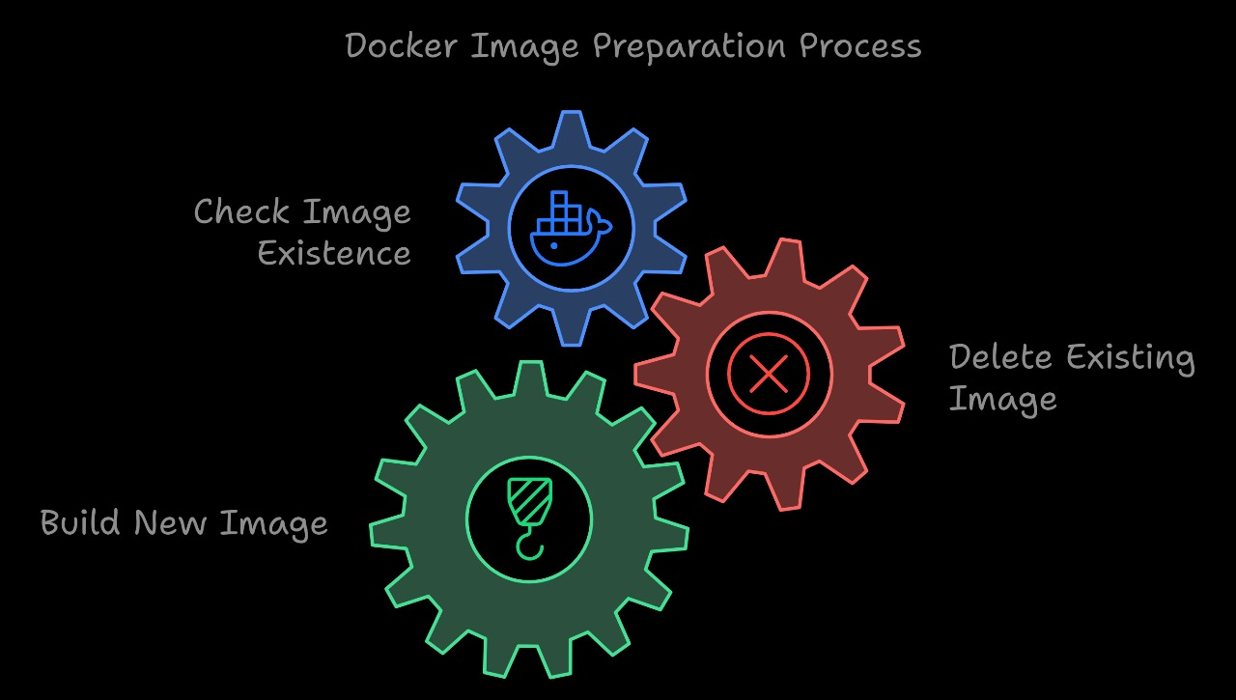
Stage 3: Prepare Docker Image
Purpose:
This check prevents conflicts with previous builds and ensures we're starting fresh.
Explain:
This stage checks if a Docker image with the same name already exists and removes it to avoid conflicts during the build.

Slide 11
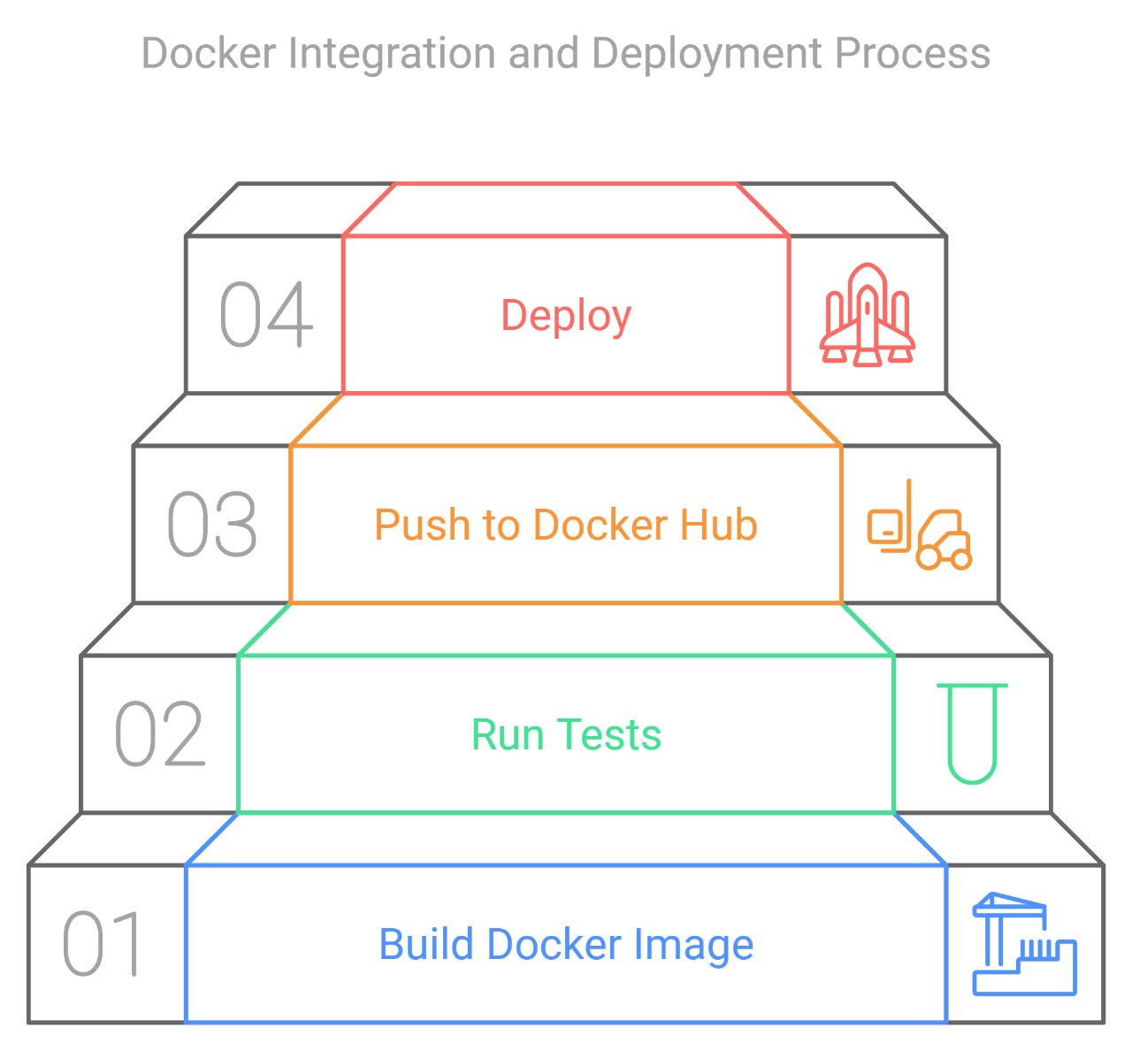
Building and deployment Stages

Slide 12
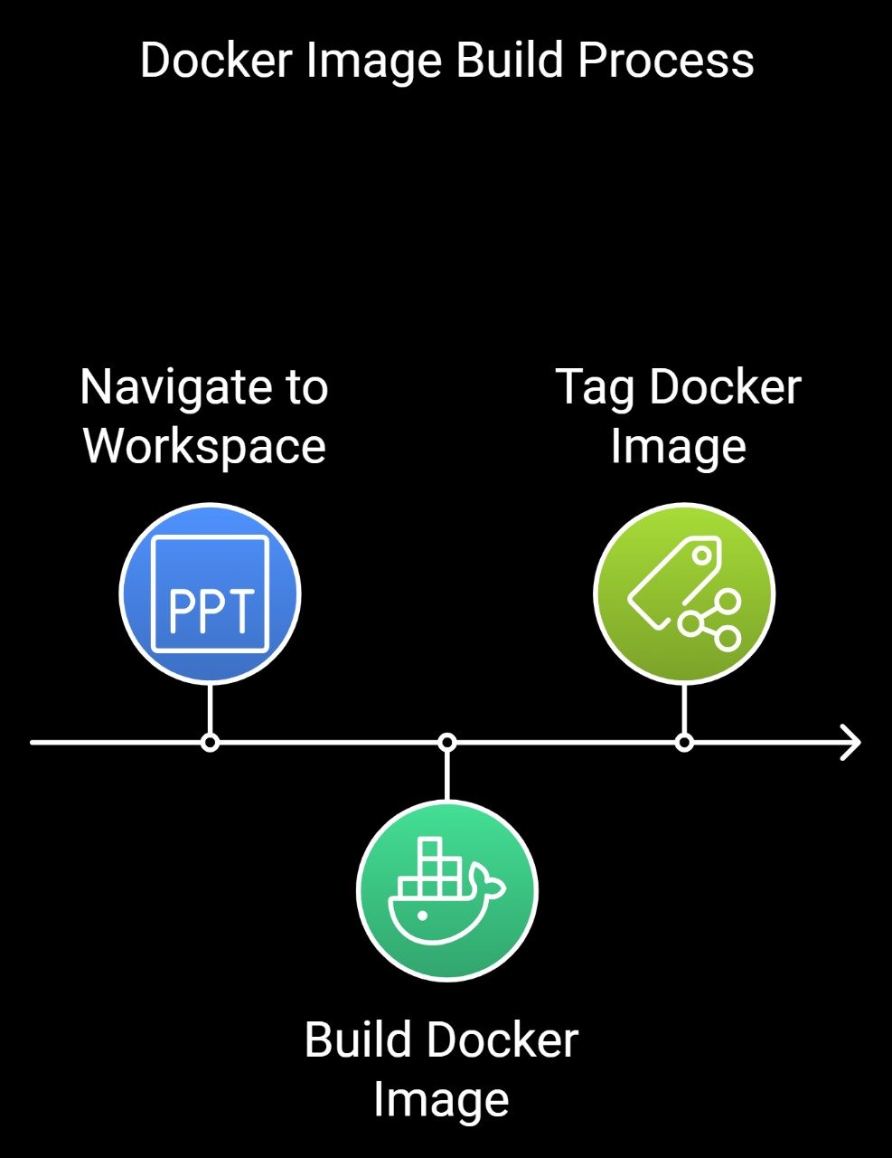
Stage 4: Build Docker Image
Purpose:
Build a new Docker image using the Docker Compose tool
Explain:
The pipeline builds the Docker image from the docker-compose.yml file and tags it with the latest version.

Slide 13
Docker File

Slide 14
Docker File
FROM python:3.9-slim
The container uses a lightweight version of Python 3.9 as the base image to reduce the image size.
WORKDIR /usr/src/app
It sets /usr/src/app for executing all further commands as the working directory where all further commands will be executed.
COPY . .
Copies all files from the current directory on the host into the container at the specified working directory (/usr/src/app).

Slide 15
Docker File
COPY requirements.txt ./
Copies the requirements.txt file to the container:
redis==3.0.1: This is a Python client for Redis, which is used to interact with a Redis database from the Python application.
tornado==5.1.1: Tornado is a Python web framework and asynchronous networking library, which is often used for building scalable and non-blocking web applications.
RUN pip install --no-cache-dir -r requirements.txt
Installs all the Python dependencies listed in the requirements.txt file, using pip without caching to minimize image size.
EXPOSE 8000
Informs Docker that the container will listen on port 8000, which is typically where the app will run.

Slide 16
Docker File
ENV REDIS_HOST=redis, ENV REDIS_PORT=6379, ENV REDIS_DB=0
Sets environment variables to configure the Redis connection details. tells the application to connect to the first Redis database (database 0).
ENV HOST=0.0.0.0, ENV PORT=8000
Sets the host and port to ensure the app listens on all network interfaces inside the container.
ENV ENVIRONMENT=production
Sets the environment variable to indicate that the application is running in production mode.
CMD ["python", "app.py"]
runs the application (app.py) using Python when the container starts.

Slide 17
Docker Compose

Slide 18
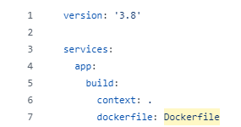
Docker Compose
version: '3.8'
Specifies the version of Docker Compose to ensure compatibility with the syntax and features used in the file.
Services represent the different components or containers that make up the application.
App Service (app)
build: Specifies how to build the Docker image for this service.
context: .: Refers to the current directory for the Docker build context.
Docker will use this folder to look for the Dockerfile and any other necessary files during the image build. dockerfile: Dockerfile: Points to the Dockerfile used to build the image.

Slide 19
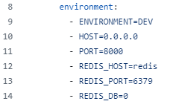

Docker Compose
Environment
Sets environment variables that will be available inside the app container
ENVIRONMENT=DEV
Specifies that the app is running in a development environment.
HOST=0.0.0.0
Ensures the app listens on all network interfaces.
PORT=8000: The port on which the app will run.
Ports: Maps port 8000 on the host machine to port 8000 in the container, allowing external access to the app.
"8000:8000": Maps port 8000 of the container to port 8000 of the host.

Slide 20
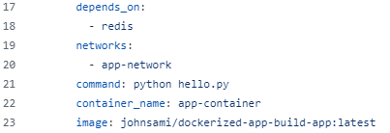
Docker Compose
depends_on: Specifies that the app service depends on the redis service. Docker Compose will ensure that Redis is started before the app service.
Redis: The app service won't start until Redis is up and running.
networks: The app service is connected to a custom network named app-network for inter-container communication.
app-network: Both services are connected to this network.
Command: Specifies the command that should run when the app container starts.
python hello.py: Runs the Python script hello.py inside the app container.
container_name: The container will be named app-container.
Image: Specifies the image to use for this service, or what the image will be tagged as after building.

Slide 21
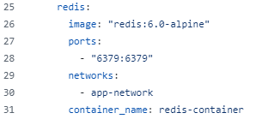

Docker Compose
Redis Service
Image: Specifies the Docker image to use for the Redis service.
Ports: Exposes Redis port 6379 to the host system.
"6379:6379“: Maps port 6379 of the container to port 6379 of the host, allowing external access to Redis.
Redis Service
networks: The redis service is also connected to the app-network for communication with the app.
app-network: Same network as the app service.
container_name: Gives a custom name to the Redis container.
app-network: a custom bridge network named app-network for the services to communicate with each other.
driver: bridge: A bridge network allows communication between containers on the same network but isolates them from external networks unless explicitly exposed.

Slide 22
Stage 5: Run Tests
Purpose:
Run unit tests to validate the application.
Explain:
This stage runs the application’s tests inside a Docker container to ensure the code is functioning properly before moving to the next stage.

Slide 23
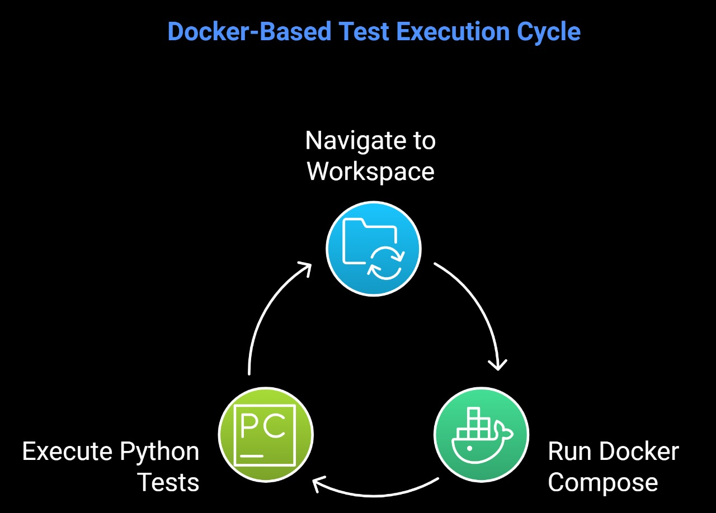
Testing

Slide 24
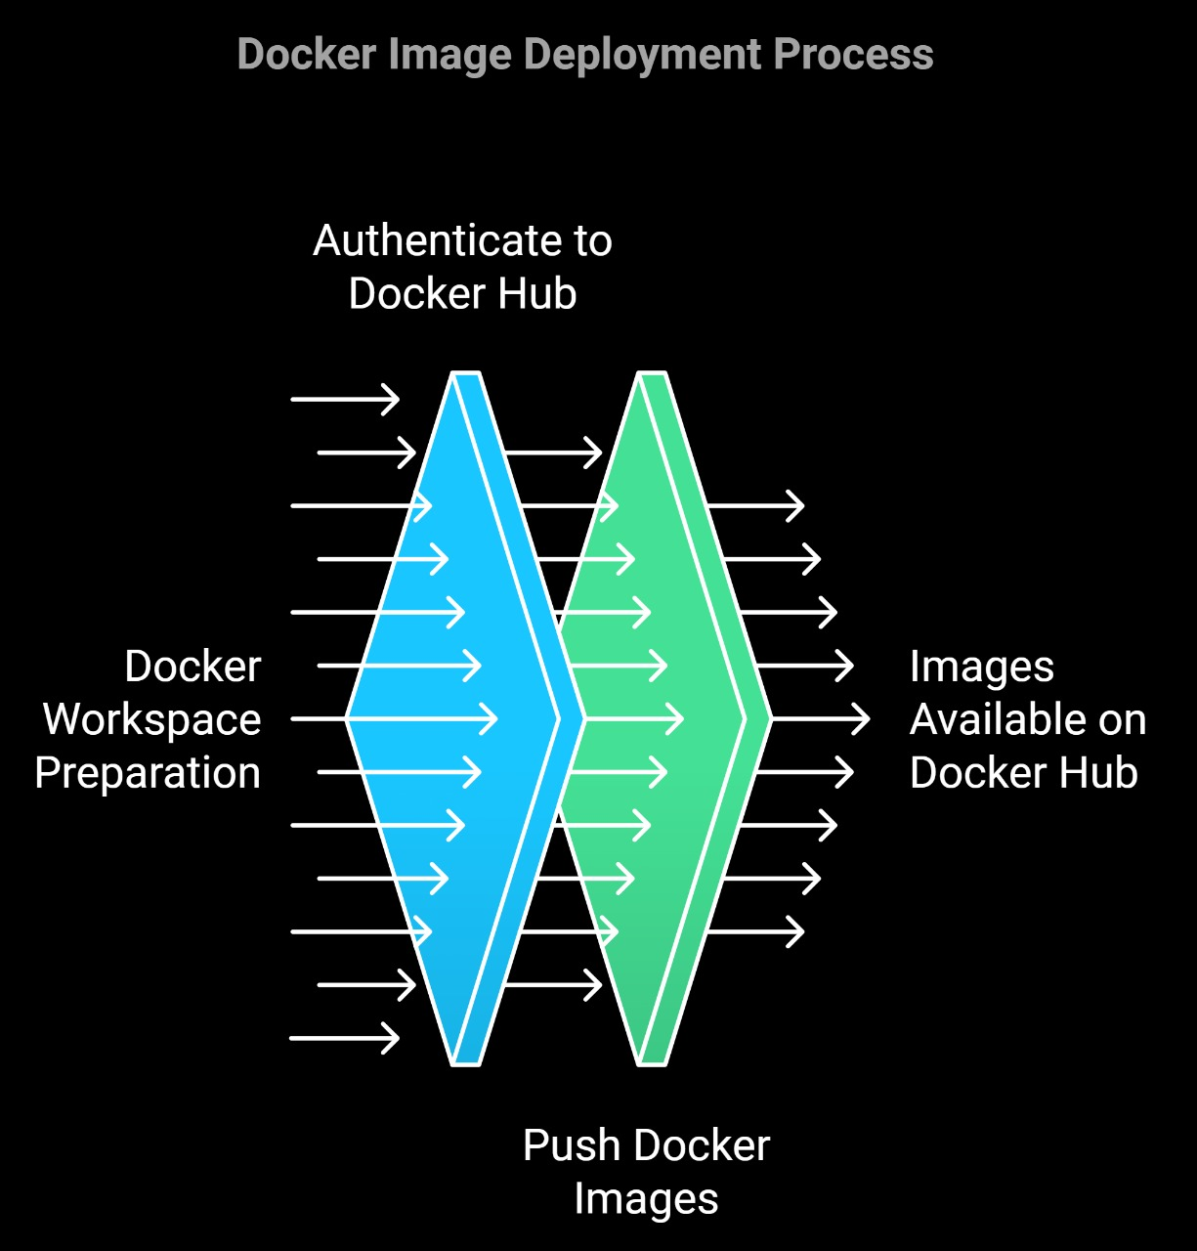
Stage 6: Push to Docker Hub
Purpose:
Push the newly built Docker image to Docker Hub.
Explain:
Logs into Docker Hub using credentials stored in Jenkins and pushes the Docker image to a public or private repository.

Slide 25
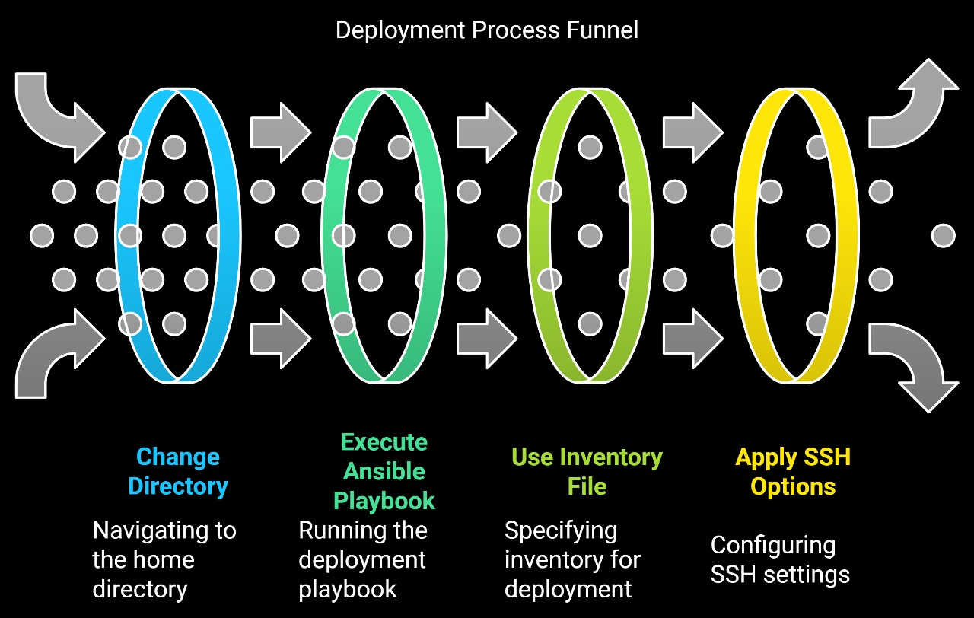
Stage 7: Deploy
Purpose:
Deploy the application using Ansible.
Explain:
This stage uses Ansible to deploy the app to a server by running the playbook from the deployment folder.

Slide 26
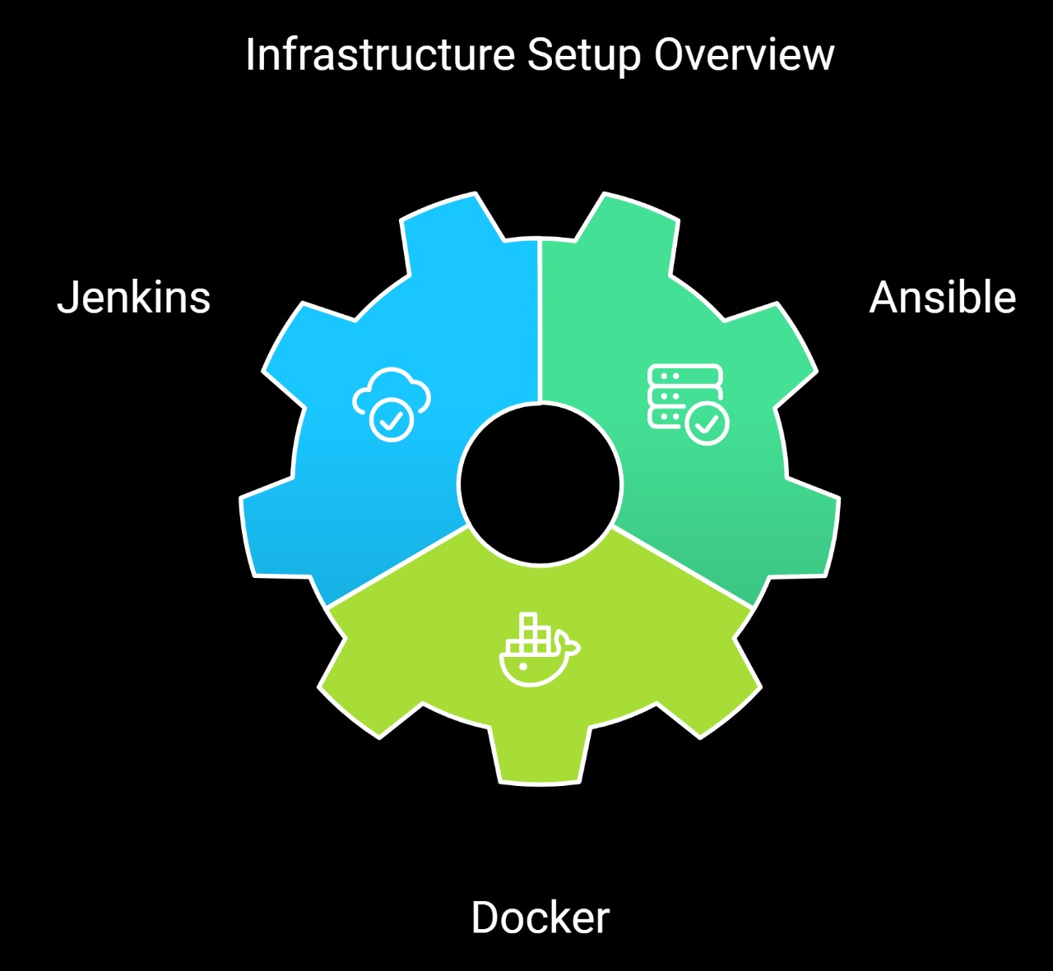
Ansible

Slide 27

Thank you for your time!

